Slide 1
403 FINAL PRESENTATION
Drew Massey
Dale Bromenshenkel
Brad Hoffman

Slide 2
Introduction

Slide 3
Requirements

Slide 4
Technical content
Computer Vision

Slide 5
SimpleCV
Overview
SimpleCV is an open source computer vision library that can implement OpenCV without a high learning curve.
Built in commands allow the use for display augmenting, image/video processing, object tracking, color mapping, color manipulation, data storage and extraction, ect.
We implement this library into python scripts.

Slide 6
Object Tracking

Slide 7
Object Tracking
Combined object tracking techniques
Blobs
The blobs command is a predetermined script that allows for object detection.
By implementing this command we do not have to re-invent the wheel.
Ability to detect different geometric shapes, color, edges, data each blob contains.
Camera/Display
Allow the use to open and manipulate video through display
Image Processing
HSV and RGB color schemes
Historgrams
Image segmentation

Slide 8
Color Mapping/Manipulation
RGB Color Scheme
Theory every image contains Red, Green and Blue fundamental colors.
Pixelated and mapped on screen with Red, Green and Blue pixels values
RGB in SimpleCV
By importing simpleCV into our base code we can segment images into RGB components.
Pushing back color in correlation with our object detection can allow us to segment our object and attain coordinates of the individual object minus its surrounding.

Slide 9
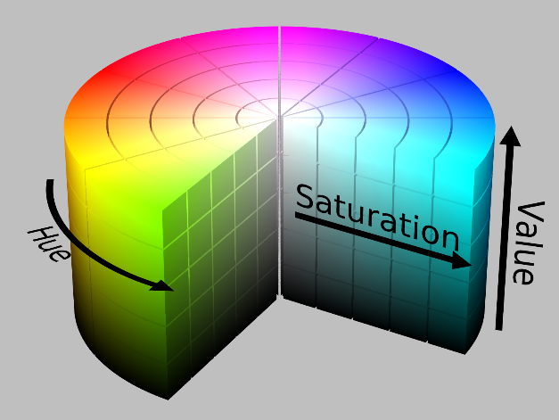
Color Mapping/Manipulation
HSV Color Scheme
Hue, Saturation, Value
Hue = Color in General
Saturation = Presence of White
Value = Brightness of Color
HSV unlike RGB allows for a wider range of color and manipulation
No need to segment using Red, Green and Blue. We can use direct values of color.
HSV can be directly implemented and imported into python script using simpleCV.

Slide 10
Design and Testing Options
Controlled conditions
Perfect light
Background
Color of object
Testing RGB vs. HSV
Histograms = Map of image in pixel values
Testing Object Tracking through the use of visual effects.
Set color scheme to gray scale to perfect object detection.
Saving Coordinates of objects to text file

Slide 11
Technical content
Raspberry Pi Robot

Slide 12
Overview of Robot
The robot has two powered wheels and a third to balance it.
Each wheel will be powered by a DC motor.
These DC motors will be connected to a couple H-bridges that will allow them to spin both forward and backwards.
The movements will be executed by the Pi, with commands sent from a PC.
The robot will be completely wireless

Slide 13
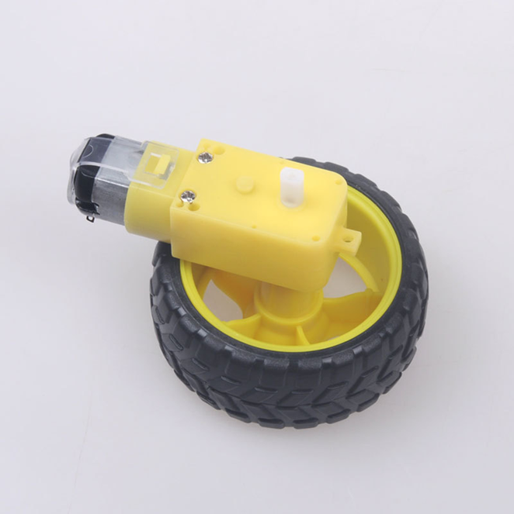
Specifics- Motors
These DC motors are capable of 200mA for a 6v input
They can move .4 Kg/cm
The wheels snap right on to the output
There is a 1:48 gear ratio

Slide 14
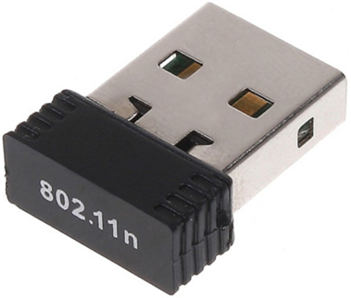
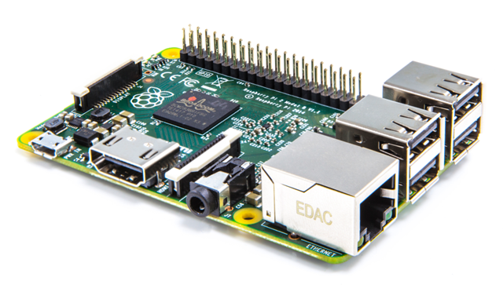
Specifics- Raspberry Pi
The robot will be controlled by a Raspberry Pi 2
The GPIO pins of the Raspberry Pi will be the way the software will interact with the hardware
The Pi will be controlled wirelessly through SSH with a USB Wi-Fi dongle

Slide 15
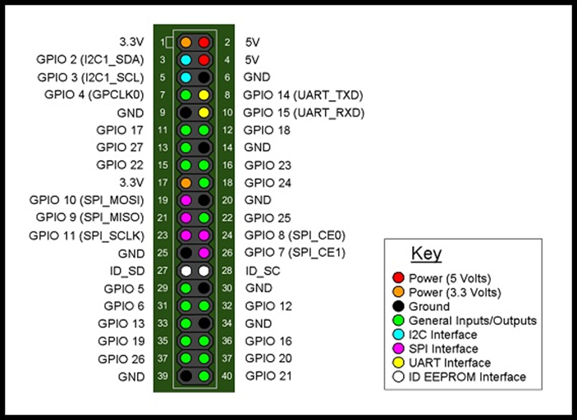
Raspberry Pi GPIO
The Raspberry Pi is equipped with 40 pins 17 of which are GPIO
The motors will be controlled from GPIO pins 17, 18, 22, 23
4 pins are needed because 17 and 18 control one motor forward and reverse and 22 and 23 for the other motor
The GPIO pins output 3.3v

Slide 16
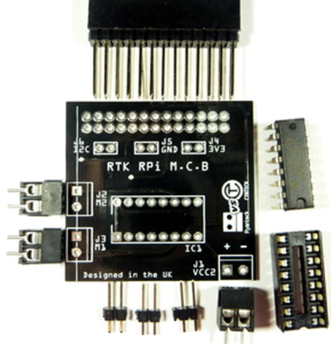
Ryanteck Motor control board
This is a pre-built board specifically for the Raspberry Pi
Its purpose is to control two motors and allow them to go forward and backwards
Allows for a separate source of power to drive the motors, because the Pi cannot supply enough current.
The board uses the TI chip SN754410NE, which is a quadruple high-current half-H driver

Slide 17
Body for the robot
We will be designing the body of the robot to house the components.
The body will be 3D printed.
The top will have two distinguishable marks on it that the camera will be able to detect for location and direction.

Slide 18
Power for the robot
Raspberry Pi Power
Motor Power
The Raspberry Pi requires 5 volts to run from a standard micro USB port
For this we thought a portable USB charging pack would work the best
These charging packs are commonly used for cell phones and output 5 volts
I had one on hand that had a capacity of 2200mAh
After testing it lasted over 2 hours before needing a charge
The motors operate at 6 volts so the USB power pack could have probably worked but we decided to go with batteries instead
4 AA batteries in series output 6 volts and are a perfect solution to power the motors

Slide 19
Code for the robot
The code that is on the Pi is written in python.
The robot is coded to have 5 main actions: Forward, Reverse, Turn Left, Turn Right, and Stop.
We set it up to react to keyboard inputs in such a way that: W=forward, S= Reverse, A=Left, D=Right, Q= Stop.
GPIO pins 17 and 18 are for motor 1 and 22 and 23 are for motor 2.
 | Forward | Reverse | Turn Left | Turn Right | Stop
GPIO 17 | 1 | 0 | 0 | 1 | 0
GPIO 18 | 0 | 1 | 1 | 0 | 0
GPIO 22 | 1 | 0 | 1 | 0 | 0
GPIO 23 | 0 | 1 | 0 | 1 | 0

Slide 20
Wireless Interaction
The Pi needs to be able to receive commands wirelessly.
We researched many ways to do this and found a solution that works over the network that both the PC that is sending the commands and the Pi are connected to.
The way we are doing it is through an SSH connection using PuTTy and using the python module called SendKeys

Slide 21
Technical Content
Application

